Slide 1
Programming Machine Learning Applications
Lecture Six: Regression and Gradient Descent
Dr. Aleksandar Velkoski

Slide 2
Review of Lecture Five
Text Classification
Recommender Systems

Slide 3
Lecture Six
Regression
Gradient Descent
Discuss Code

Slide 4
Regression

Slide 5
What is Numeric Prediction
(Numerical) prediction is similar to classification
construct a model
use model to predict value for a given input
Prediction is different from classification
Classification refers to predicting categorical class label
Prediction models continuous-valued functions
Major method for prediction: regression
model the relationship between one or more independent or predictor variables and a dependent or response variable
Regression analysis
Linear and multiple regression
Non-linear regression
Other regression methods: generalized linear model, Poisson regression, log-linear models, regression trees

Slide 6
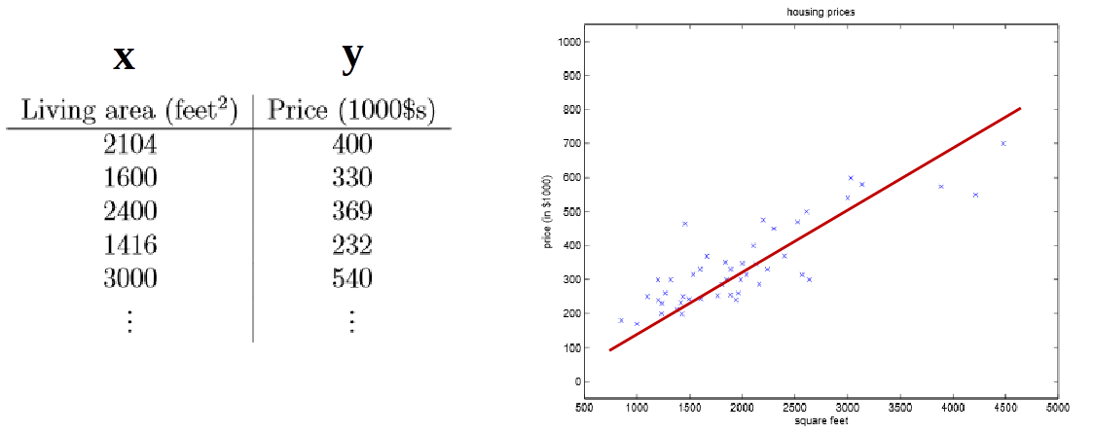
Simple Linear Regression
Simple linear regression: involves a response variable y and a single predictor variable x
where y = w₀ + w₁x
Goal: Use data to estimate weights (parameters) w₀ and w₁ such that prediction error is minimized

Slide 7
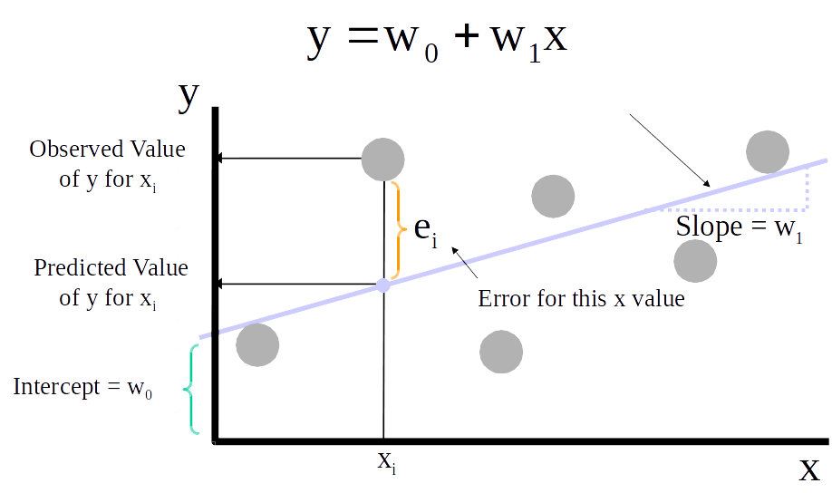
Simple Linear Regression

Slide 8
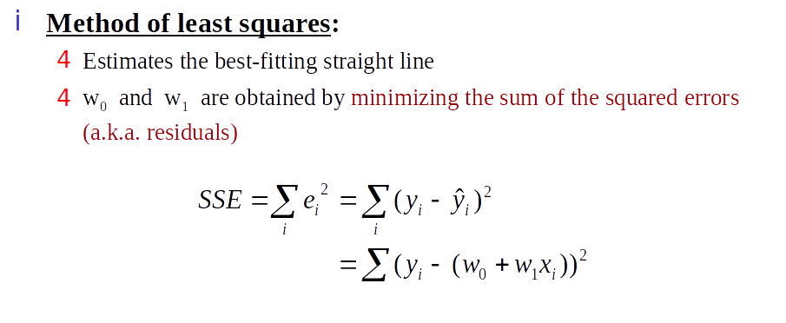
Simple Linear Regression

Slide 9
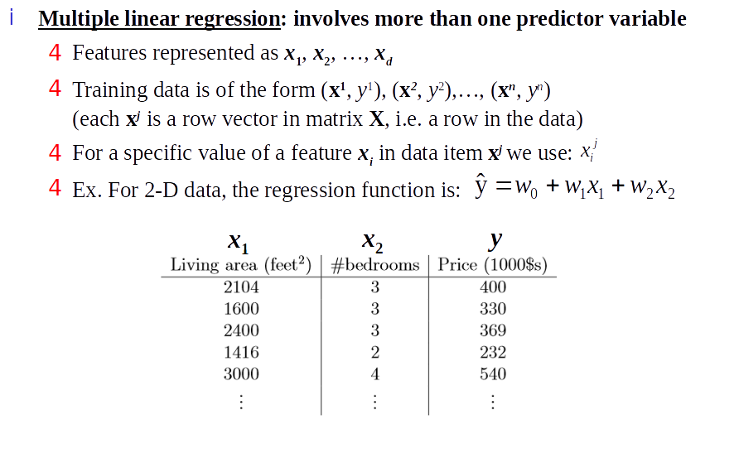
Multiple Linear Regression

Slide 10
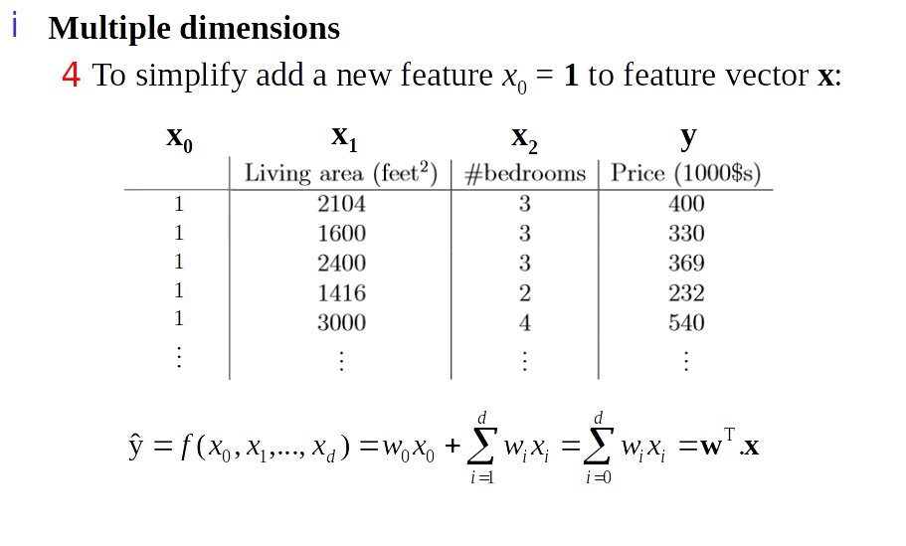
Least Squares Generalization

Slide 11
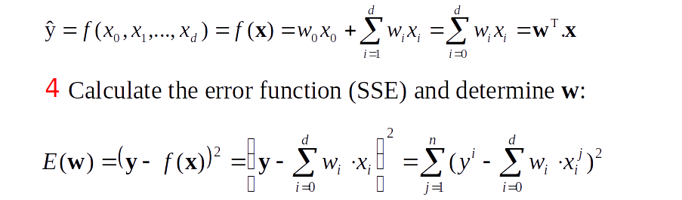
Least Squares Generalization

Slide 12
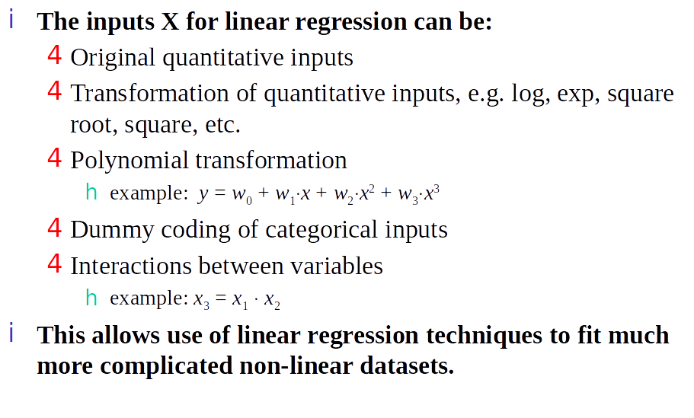
Application of Linear Regression

Slide 13
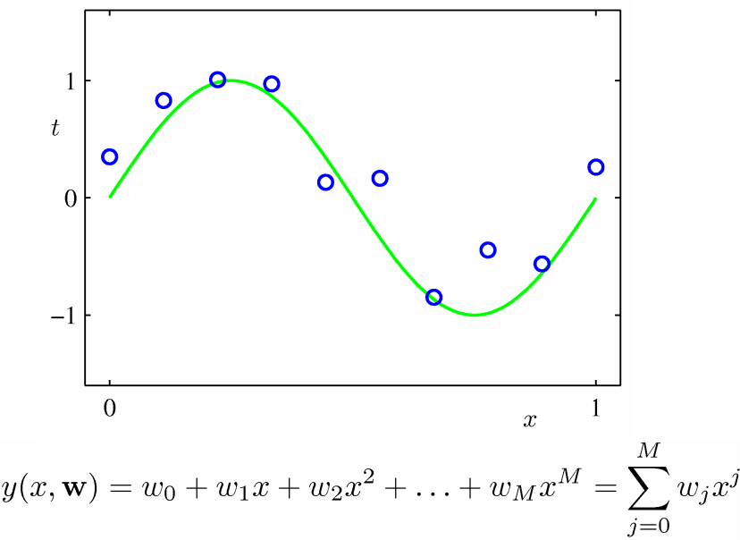
Fitting Polynomial with Linear Model

Slide 14
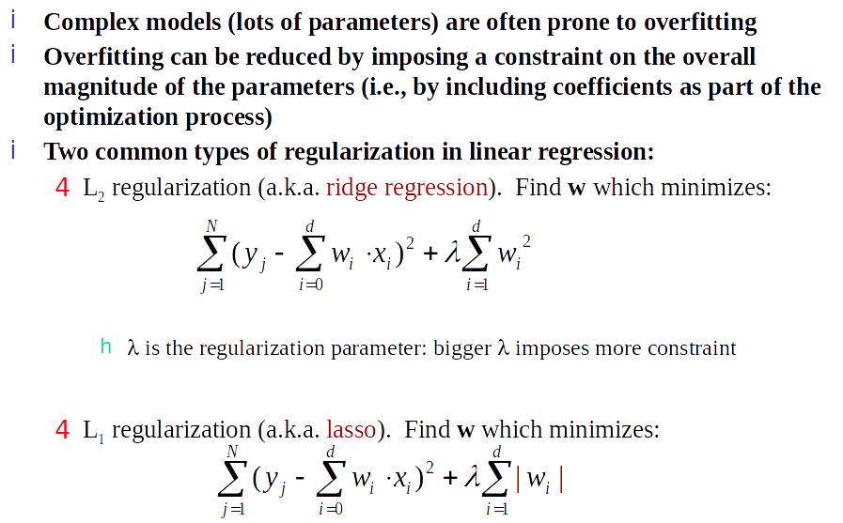
Regularization

Slide 15
Other Regression-Based Models
Generalized linear models
Foundation on which linear regression can be applied to modeling categorical response variables
Variance of y is a function of the mean value of y, not a constant
Logistic regression: models the probability of some event occurring as a linear function of a set of predictor variables
Poisson regression: models the data that exhibit a Poisson distribution
Log-linear models (for categorical data)
Approximate discrete multidimensional prob. distributions
Also useful for data compression and smoothing
Regression trees and model trees
Trees to predict continuous values rather than class labels

Slide 16
Regression Trees & Model Trees
Regression tree: proposed in CART system (Breiman et al. 1984)
CART: Classification And Regression Trees
Each leaf stores a continuous-valued prediction
It is the average value of the predicted attribute for the training instances that reach the leaf
Model tree: proposed by Quinlan (1992)
Each leaf holds a regression model—a multivariate linear equation for the predicted attribute
A more general case than regression tree
Regression and model trees tend to be more accurate than linear regression when instances are not represented well by simple linear models

Slide 17
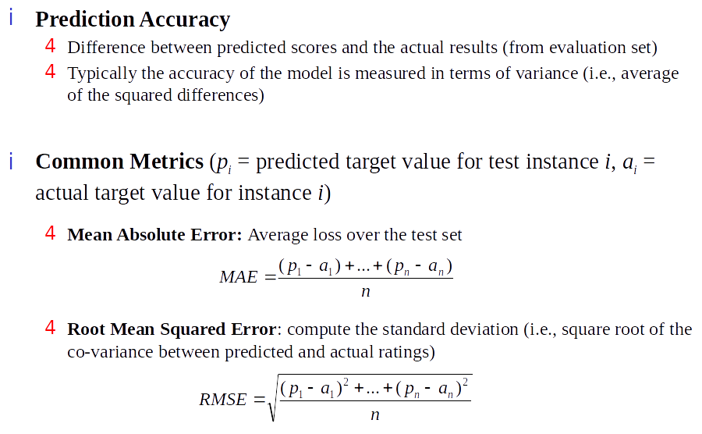
Evaluating Regression Models

Slide 18
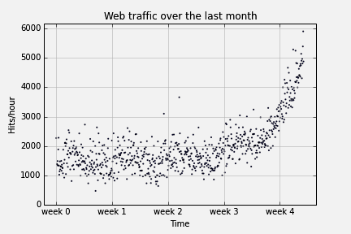
Example: Web Traffic

Slide 19
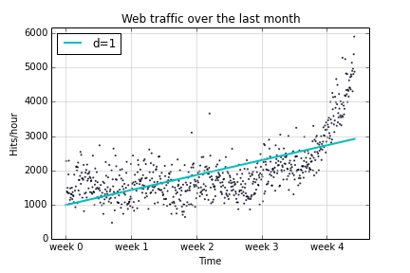
Example: Web Traffic 1d Fit

Slide 20
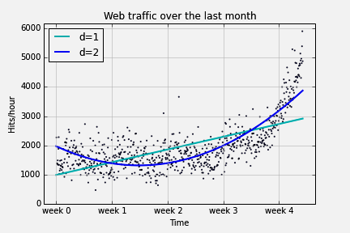
Example: Web Traffic 2d Fit

Slide 21
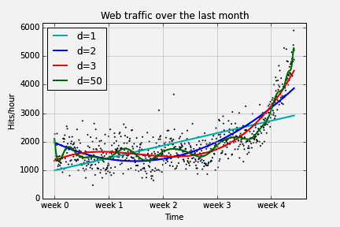
Example: Web Traffic Beyond 2d Fit

Slide 22
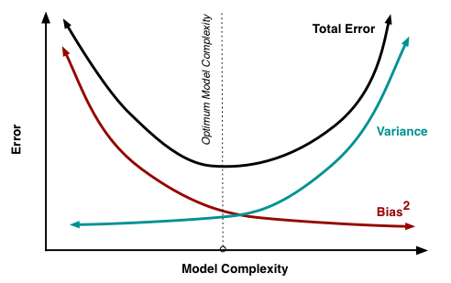
Model Complexity
Source: http://www.cs.cornell.edu/courses/cs4780/2015fa/web/lecturenotes/lecturenote12.html

Slide 23
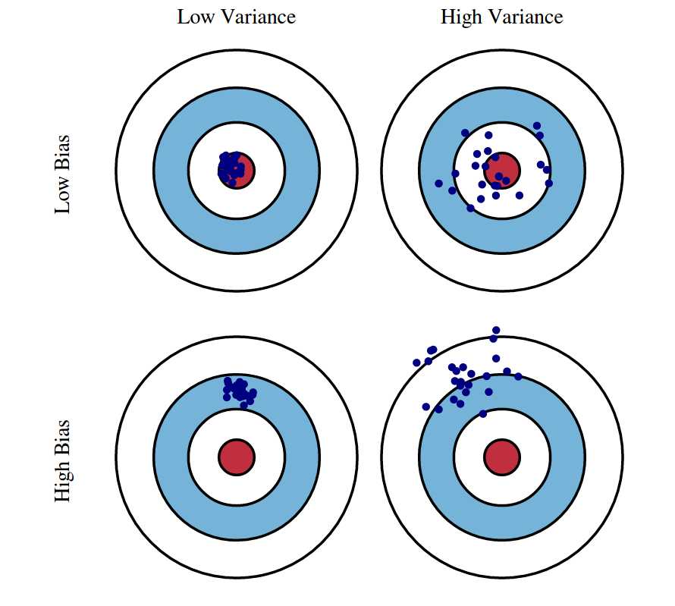
Bias-Variance Tradeoff
Source: http://www.cs.cornell.edu/courses/cs4780/2015fa/web/lecturenotes/lecturenote12.html

Slide 24
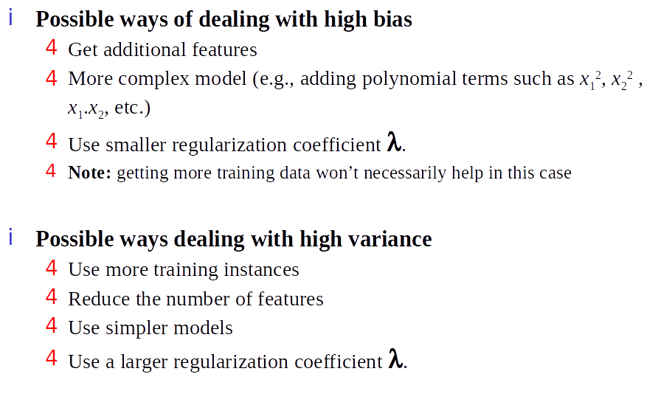
Bias-Variance Tradeoff

Slide 25
Gradient Descent

Slide 26
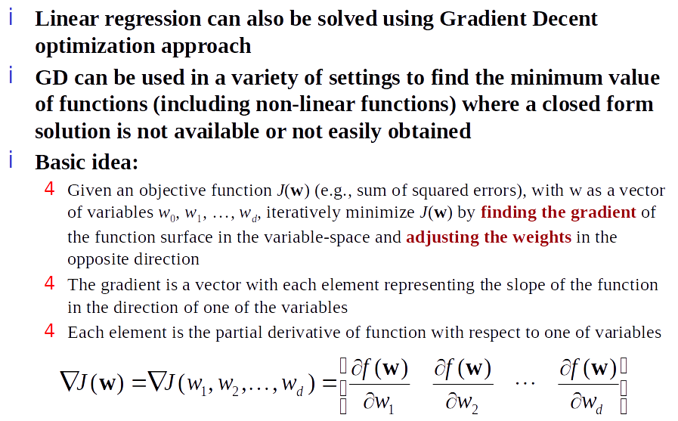
Gradient Descent Optimization

Slide 27
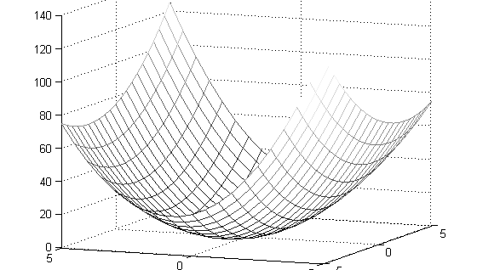
Gradient Descent Optimization

Slide 28
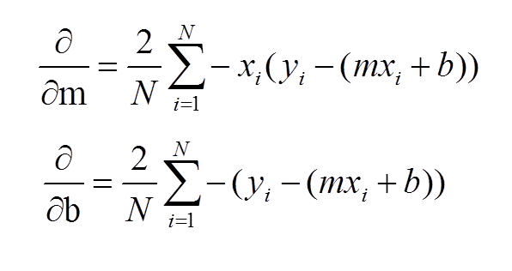
Gradient is a Vector

Slide 29
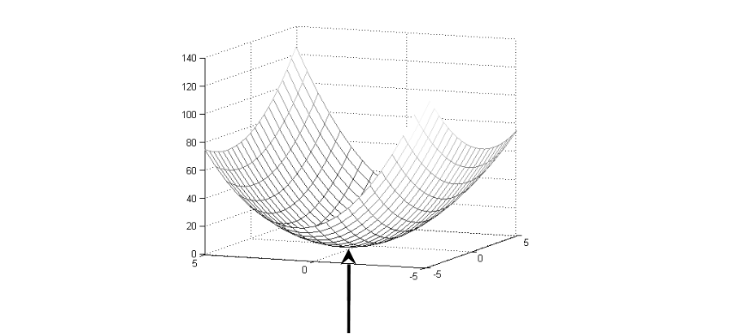
Gradient Descent Optimization
Gradient vector points in the direction of the steepest ascent of function

Slide 30
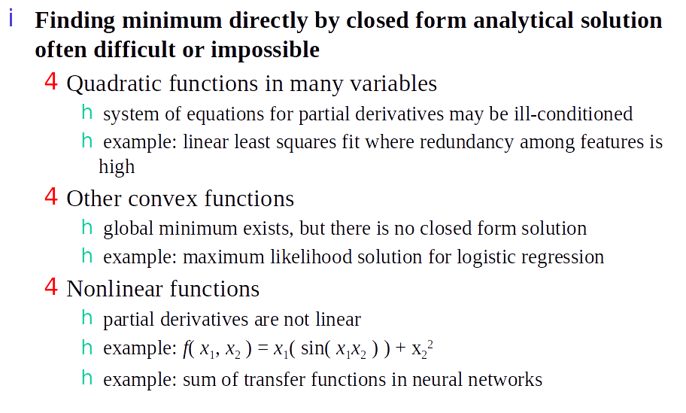
Gradient Descent Optimization

Slide 31
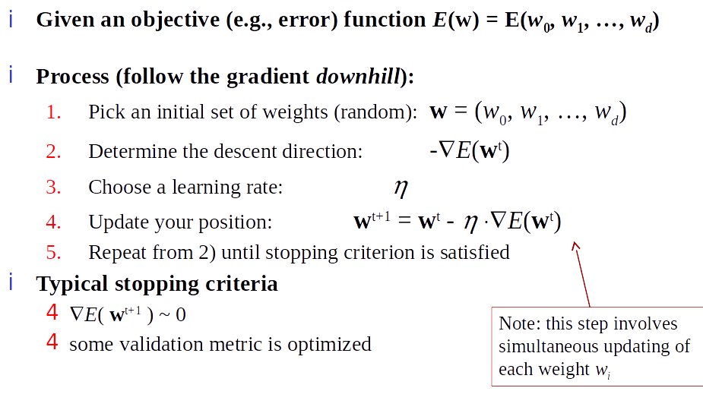
Gradient Descent Optimization

Slide 32
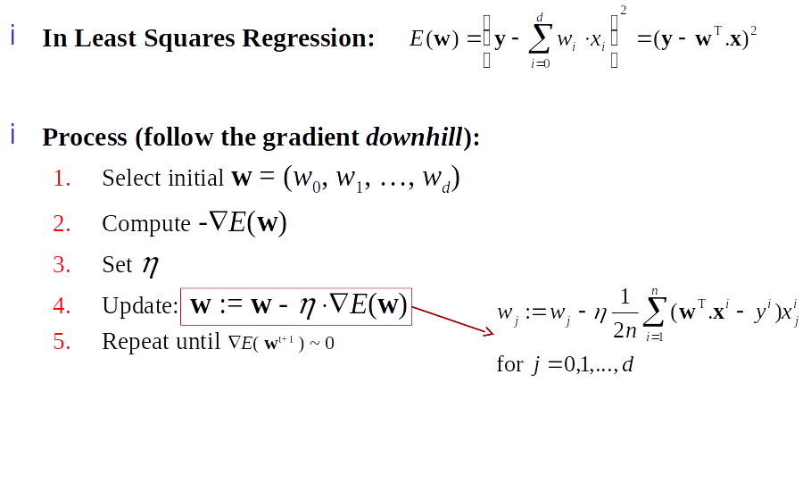
Gradient Descent Optimization

Slide 33
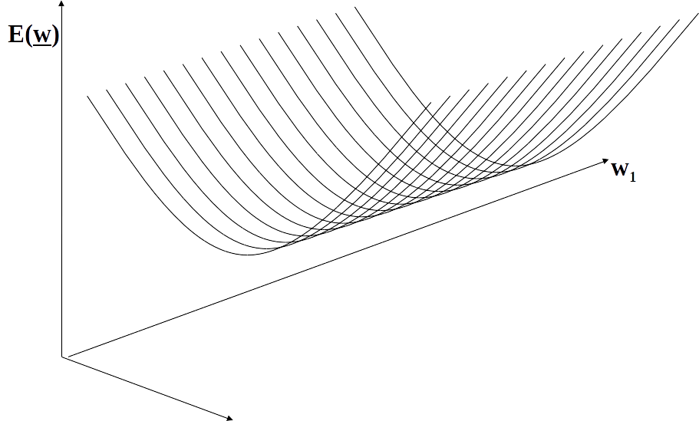
Illustration

Slide 34
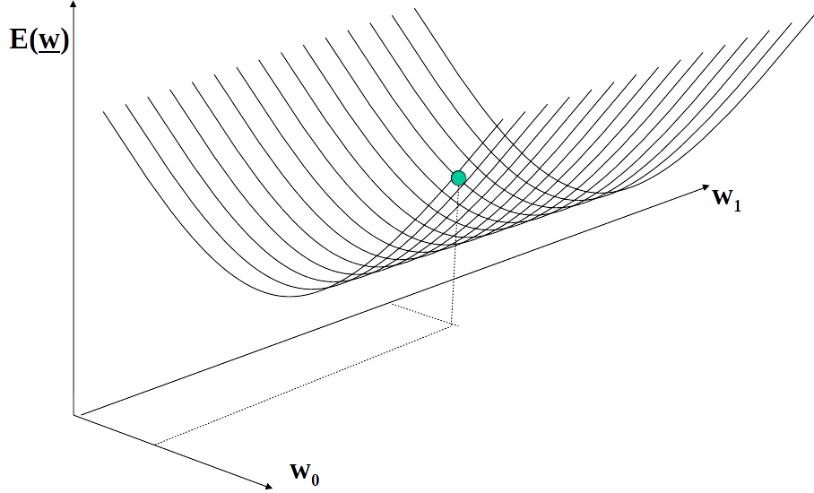
Illustration

Slide 35
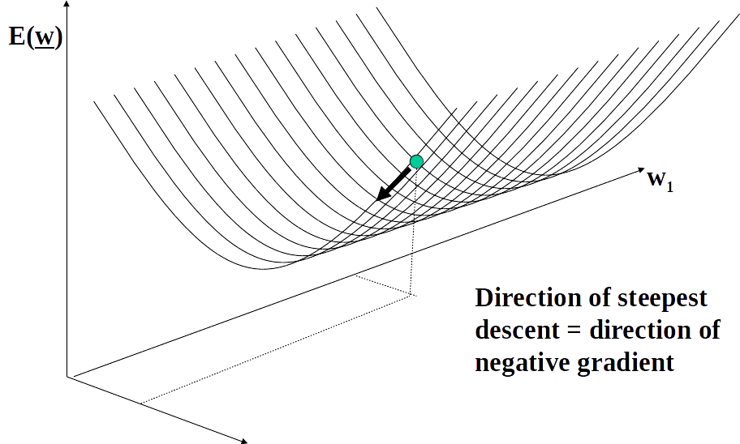
Illustration

Slide 36
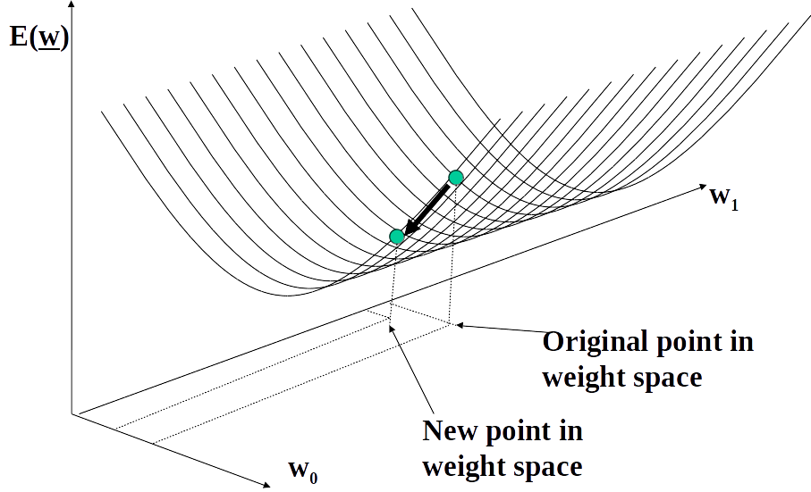
Illustration

Slide 37
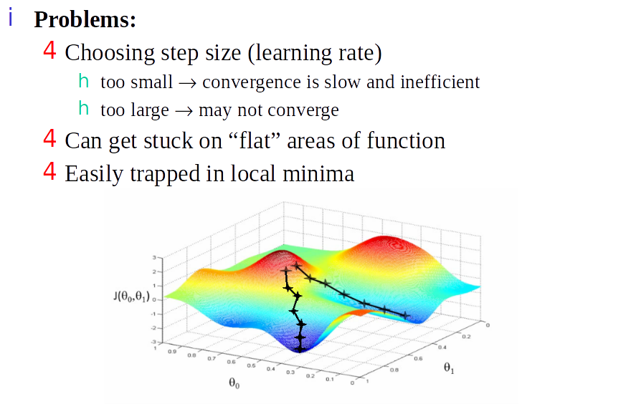
Gradient Descent Optimization

Slide 38
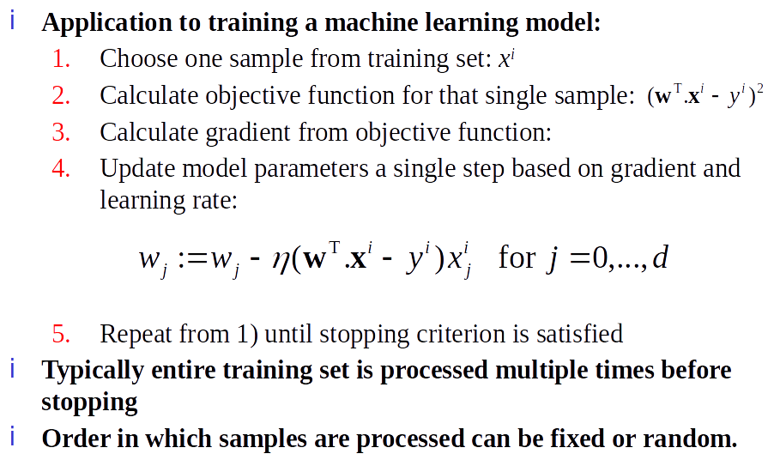
Stochastic Gradient Descent

Slide 39
Code

Slide 40
Questions
Wrapping-up the Lecture

Slide 41
What is the goal of Linear Regression?

Slide 42
Describe two types of Regularization. What’s the intuition of each type?

Slide 43
Why is getting trapped in a local minima a problem in Gradient Descent?

